Slide 1
On-line Reinforcement Learning Obstacle avoidance with Evolutionary Algorithm
Project Activity of Artificial Intelligence Master Computer Engineering
University of Bologna
Student:
Krystian Koss
Professors:
Prof. Andrea Roli
Prof. Paola Mello
Notes:
1

Slide 2
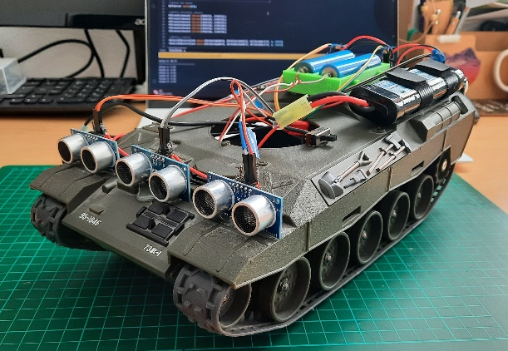
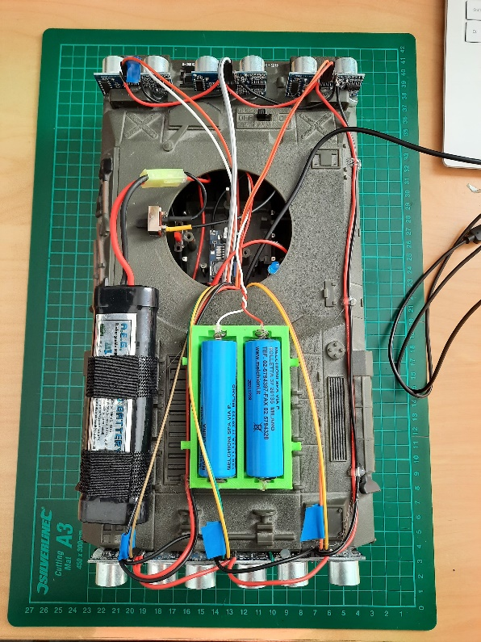
Experiment preparations
Main components:
2 front ultrasonic sensors
2 back ultrasonic sensors
2 motors enabled to both directions
Internal working values:
The sensors measure distances in terms of centimeters from 1 to 400
Motors work with values in the range 120 (still) to 255 (max speed) must be sent.
Battery lifetime: 1 hour 30 minutes
Goal: avoid obstacles while it keeps going at a minim constant speed
2

Slide 3
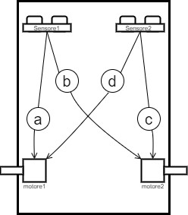
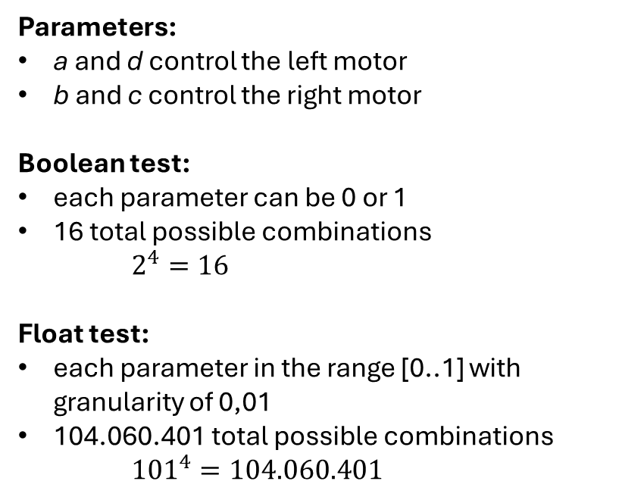
Braitenberg architecture 1/2
Parameters:
a and d control the left motor
b and c control the right motor
Boolean test:
each parameter can be 0 or 1
16 total possible combinations
$2^{4}=16$
Float test:
each parameter in the range [0..1] with granularity of 0,01
104.060.401 total possible combinations
${101}^{4}=104.060.401$
3

Slide 4
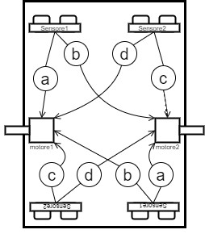
Braitenberg architecture 2/2
Double Braitenberg:
because this architecture can’t avoid walls we ignore wall collisions
symmetric architectures
4

Slide 5
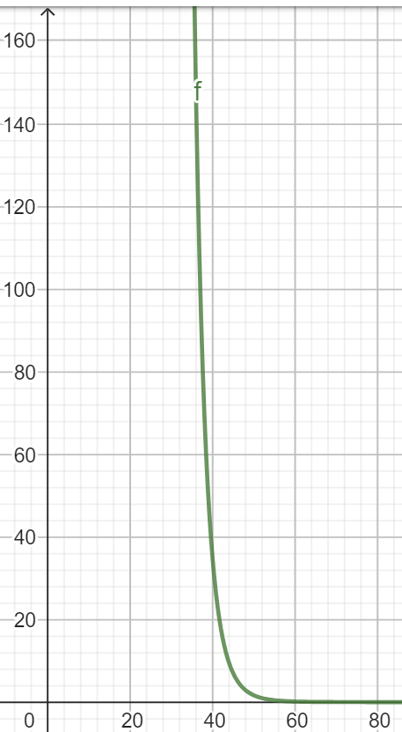
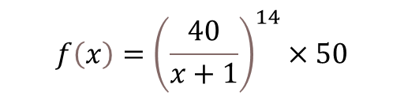
Behavior & score function
Behavior function:
$$f\left(x\right)={\left(\frac{40}{x+1}\right)}^{14}×50$$
V1=v0 + f(distance sensor1)×a + f(distance sensor2)×d
V2=v0 + f(distance sensor1)×b + f(distance sensor2)×c
Where:
V0 = 130 is the constant angular speed
V1 is the left motor speed
V2 is the right motor speed
Score function:
-1 for each ‘object avoided’
+2 for each ‘obstacle collision’
5

Slide 6
Evolutionary Algorithm
initialize random individual
score = start_epoch(individual)
best_score = score
best_individual = individual
individual = apply_random_mutation(best_individual)
loop (totalEpochs-1) times
score = start_epoch(individual)
if (actual score better than best_score)
best_score = score
best_individual = individual
individual = apply_random_mutation(best_individual)
best_individual represents the final genes
6

Slide 7
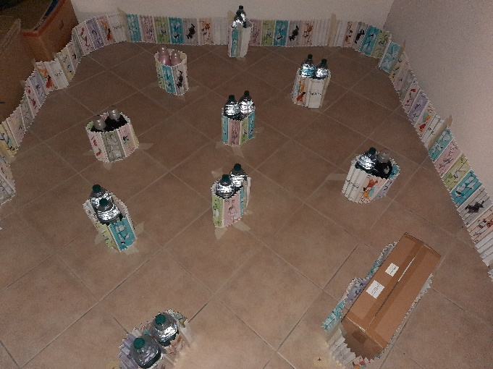

Test Arena
7

Slide 8
Boolean test
Settings:
30 epochs 30 seconds each
Result:
Learned the right combination after 16-20 epochs
Good result?
Reasonable. The total possible combinations are 16, but here the robot can gain two different scores with the same combination in two different epochs, trying inevitably same combinations multiple times
Problem:
Working on not precise data and not being able to directly compare two scores of two different epochs
8

Slide 9
Float test
Settings:
60 epochs 60 seconds each
Result:
No Learning at all
Good result?
No, but there is little we can do: we don’t have the concept of ‘slight improvement’.
Problem:
Working on not precise data and not being able to directly compare two scores of two different epochs
9

Slide 10
Possible solutions
Three solutions identified:
Reduce dimensionality of search space
Using gradient
Bayesian optimization
Both require precise data
We would not get max potential from these methods
, then in the second half we reintroduce the original size with small mutations (delta max = 0,15)
First half epochs:
[ 0 ; 0,25 ; 0,50 ; 0,75 ; 1 ]
Other variations has been tried, but without improvement
10

Slide 11
Conclusions
Infeasibility of using on-line Reinforcement Learning with Evolutionary Algorithms for obstacle avoidance with little information about the environment and with inaccuracies of data
We can’t use the crossover, which represents the most important operator of Genetics Alghorithms
If we cannot completely trust our sensors we cannot make strong assumptions about the performance
A hybrid solution should be perfect: in simulation you learn basic actions intuition, then on-line you finetune the parameters with the real-world rules
Future developments:
Would be interesting to find out if it is better to have less data with different score functions or a lot of data with a single score function
11

Slide 12
Thank you for your attention
Notes:
12

